Slide 1
Tratamiento médico de la hiperplasia benigna de próstata.
Gilmer Arcenio Díaz Pérez
Urólogo – INEN
Marzo 2025

Slide 2
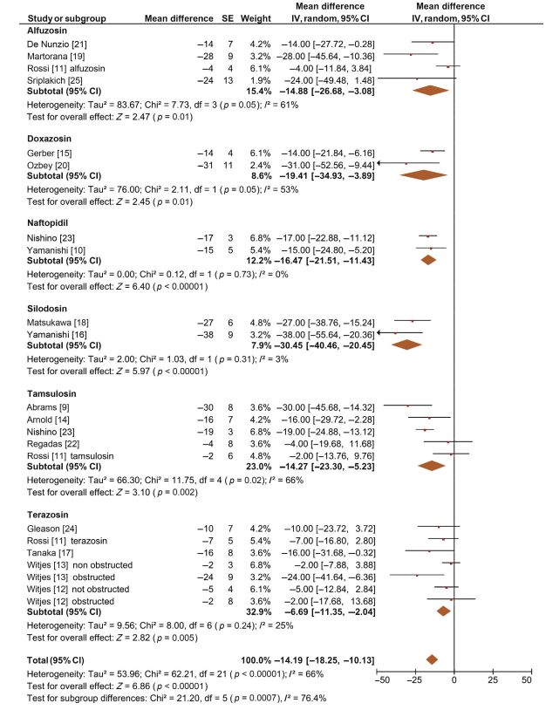
Fusco F, Palmieri A, Ficarra V, Giannarini G, Novara G, Longo N, Verze P, Creta M, Mirone V. α1-Blockers Improve Benign Prostatic Obstruction in Men with Lower Urinary Tract Symptoms: A Systematic Review and Meta-analysis of Urodynamic Studies. Eur Urol. 2016 Jun;69(6):1091-101. doi: 10.1016/j.eururo.2015.12.034. Epub 2016 Jan 28. PMID: 26831507.

Slide 3
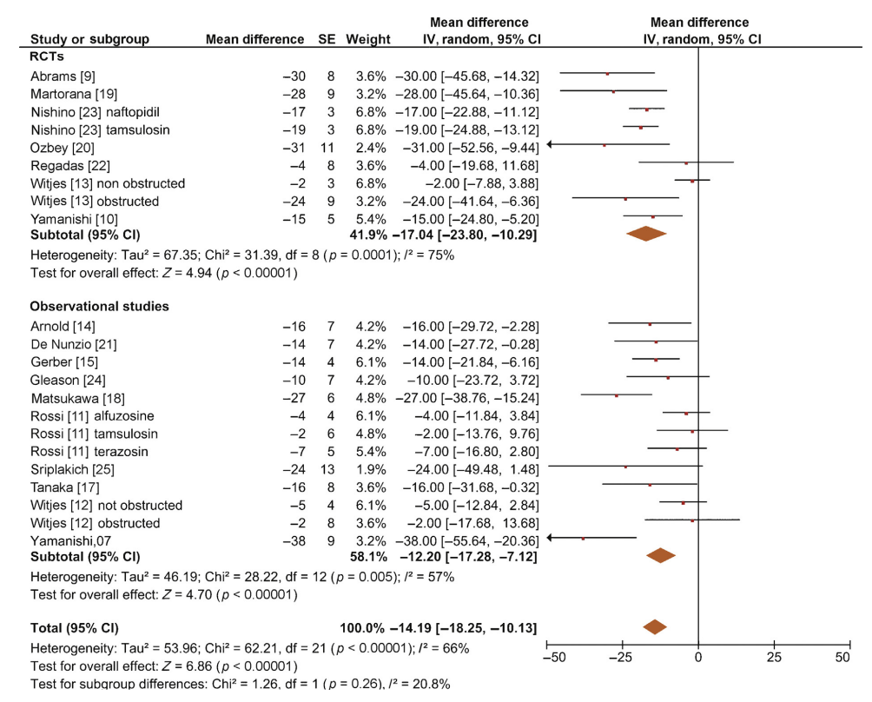
Fusco F, Palmieri A, Ficarra V, Giannarini G, Novara G, Longo N, Verze P, Creta M, Mirone V. α1-Blockers Improve Benign Prostatic Obstruction in Men with Lower Urinary Tract Symptoms: A Systematic Review and Meta-analysis of Urodynamic Studies. Eur Urol. 2016 Jun;69(6):1091-101. doi: 10.1016/j.eururo.2015.12.034. Epub 2016 Jan 28. PMID: 26831507.

Slide 4
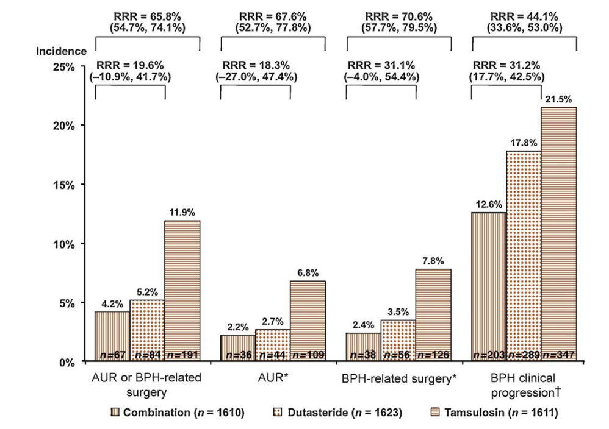
Roehrborn CG, Siami P, Barkin J, Damião R, Major-Walker K, Nandy I, Morrill BB, Gagnier RP, Montorsi F; CombAT Study Group. The effects of combination therapy with dutasteride and tamsulosin on clinical outcomes in men with symptomatic benign prostatic hyperplasia: 4-year results from the CombAT study. Eur Urol. 2010 Jan;57(1):123-31. doi: 10.1016/j.eururo.2009.09.035. Epub 2009 Sep 19. Erratum in: Eur Urol. 2010 Nov;58(5):801. PMID: 19825505.

Slide 5
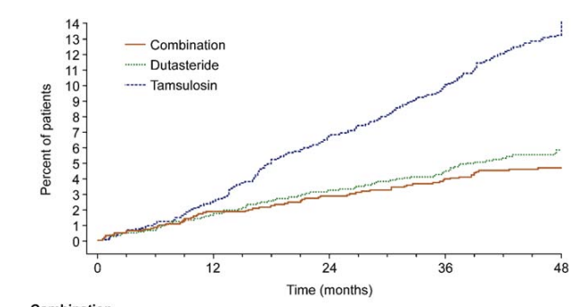
Roehrborn CG, Siami P, Barkin J, Damião R, Major-Walker K, Nandy I, Morrill BB, Gagnier RP, Montorsi F; CombAT Study Group. The effects of combination therapy with dutasteride and tamsulosin on clinical outcomes in men with symptomatic benign prostatic hyperplasia: 4-year results from the CombAT study. Eur Urol. 2010 Jan;57(1):123-31. doi: 10.1016/j.eururo.2009.09.035. Epub 2009 Sep 19. Erratum in: Eur Urol. 2010 Nov;58(5):801. PMID: 19825505.

Slide 6
Welk B, McArthur E, Fraser LA, Hayward J, Dixon S, Hwang YJ, Ordon M. The risk of fall and fracture with the initiation of a prostate-selective α antagonist: a population based cohort study. BMJ. 2015 Oct 26;351:h5398. doi: 10.1136/bmj.h5398. PMID: 26502947; PMCID: PMC4620650.

Slide 7
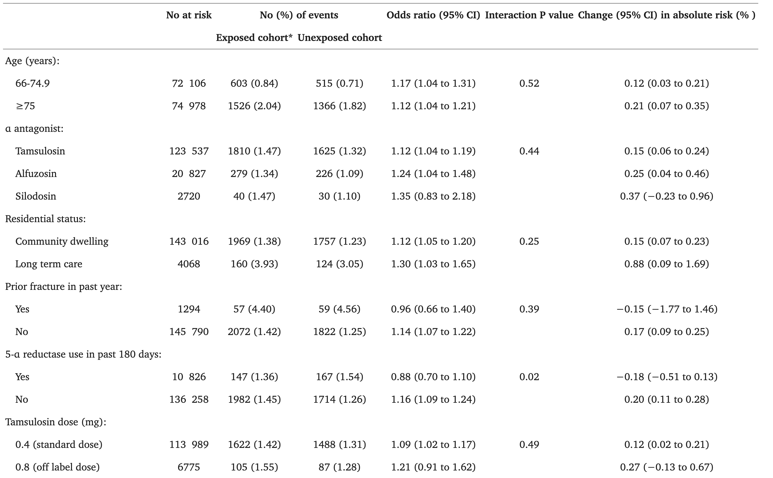
Welk B, McArthur E, Fraser LA, Hayward J, Dixon S, Hwang YJ, Ordon M. The risk of fall and fracture with the initiation of a prostate-selective α antagonist: a population based cohort study. BMJ. 2015 Oct 26;351:h5398. doi: 10.1136/bmj.h5398. PMID: 26502947; PMCID: PMC4620650.

Slide 8
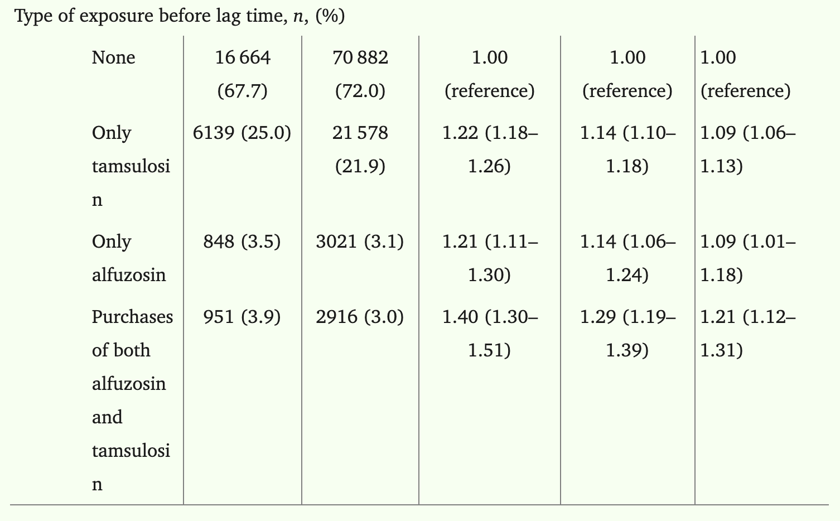
Latvala L, Tiihonen M, Murtola TJ, Hartikainen S, Tolppanen AM. Use of α1-adrenoceptor antagonists tamsulosin and alfuzosin and the risk of Alzheimer's disease. Pharmacoepidemiol Drug Saf. 2022 Oct;31(10):1110-1120. doi: 10.1002/pds.5503. Epub 2022 Jul 6. PMID: 35751619; PMCID: PMC9542191.

Slide 9
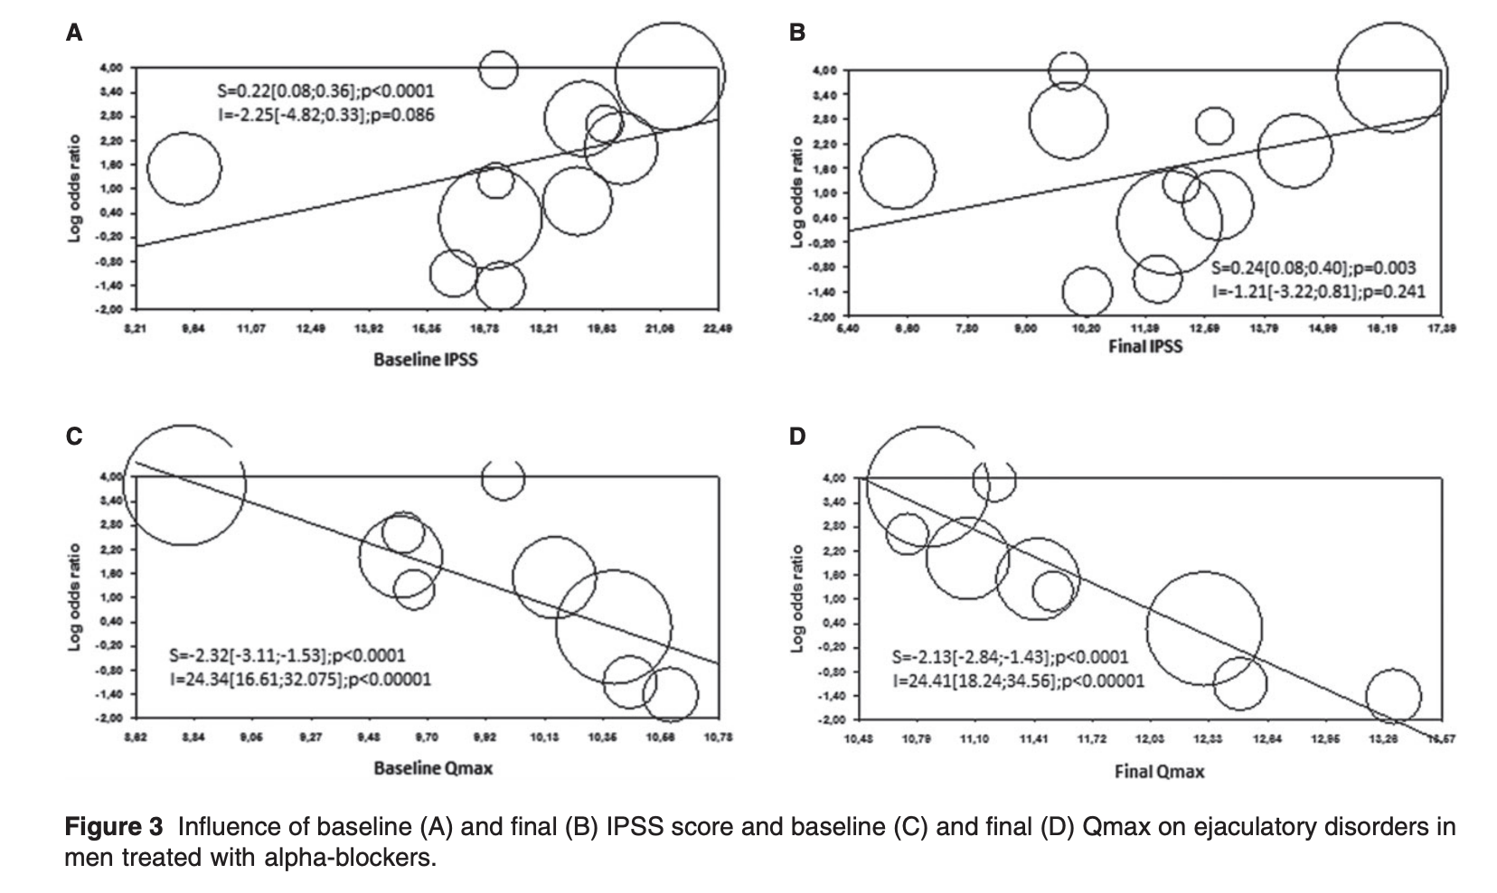
Gacci M, Ficarra V, Sebastianelli A, Corona G, Serni S, Shariat SF, Maggi M, Zattoni F, Carini M, Novara G. Impact of medical treatments for male lower urinary tract symptoms due to benign prostatic hyperplasia on ejaculatory function: a systematic review and meta-analysis. J Sex Med. 2014 Jun;11(6):1554-66. doi: 10.1111/jsm.12525. Epub 2014 Apr 7. PMID: 24708055.

Slide 10
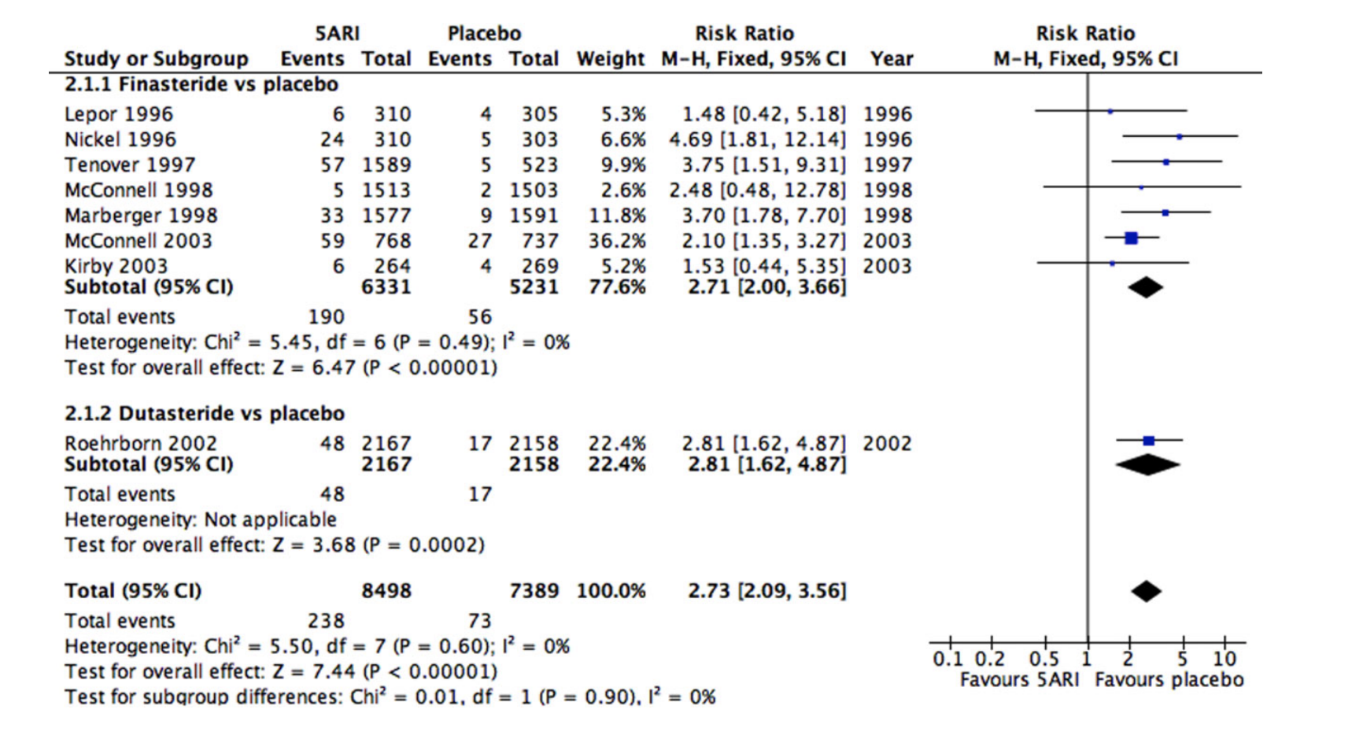
Gacci M, Ficarra V, Sebastianelli A, Corona G, Serni S, Shariat SF, Maggi M, Zattoni F, Carini M, Novara G. Impact of medical treatments for male lower urinary tract symptoms due to benign prostatic hyperplasia on ejaculatory function: a systematic review and meta-analysis. J Sex Med. 2014 Jun;11(6):1554-66. doi: 10.1111/jsm.12525. Epub 2014 Apr 7. PMID: 24708055.

Slide 11
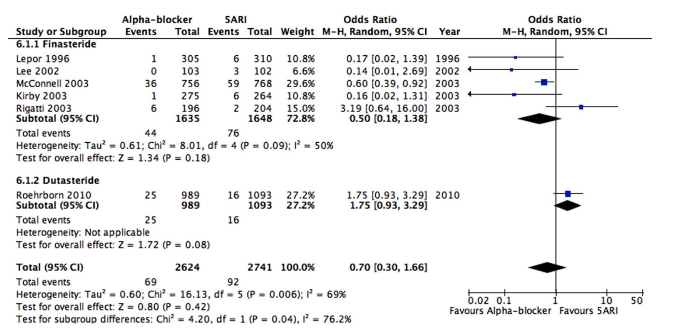
Gacci M, Ficarra V, Sebastianelli A, Corona G, Serni S, Shariat SF, Maggi M, Zattoni F, Carini M, Novara G. Impact of medical treatments for male lower urinary tract symptoms due to benign prostatic hyperplasia on ejaculatory function: a systematic review and meta-analysis. J Sex Med. 2014 Jun;11(6):1554-66. doi: 10.1111/jsm.12525. Epub 2014 Apr 7. PMID: 24708055.

Slide 12
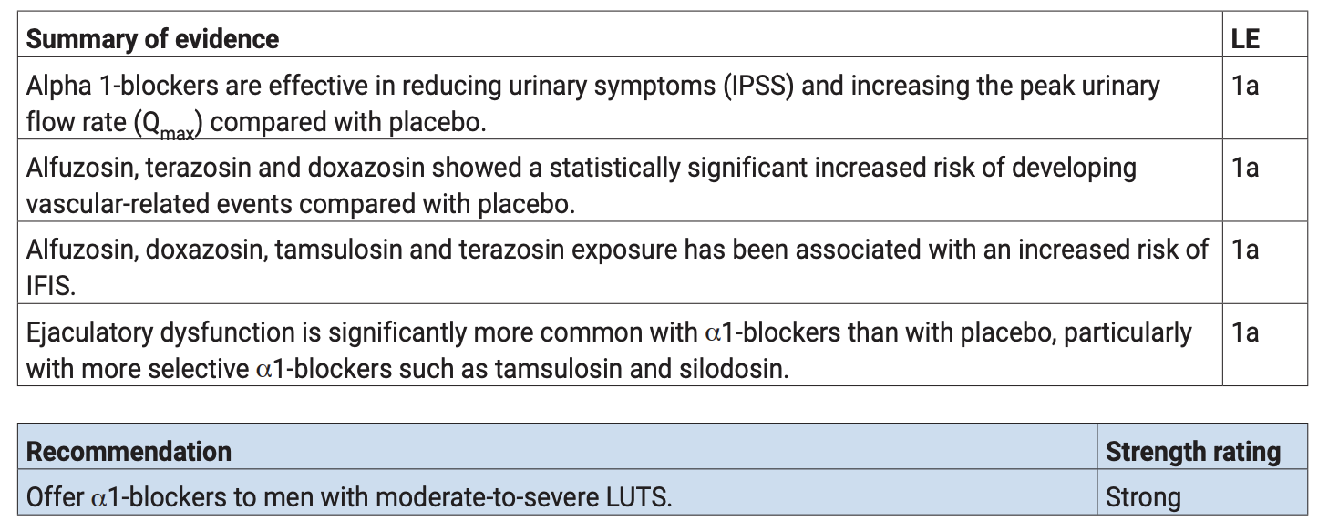
Management of Non-neurogenic Male LUTS. EAU Guidelines, 2025.

Slide 13
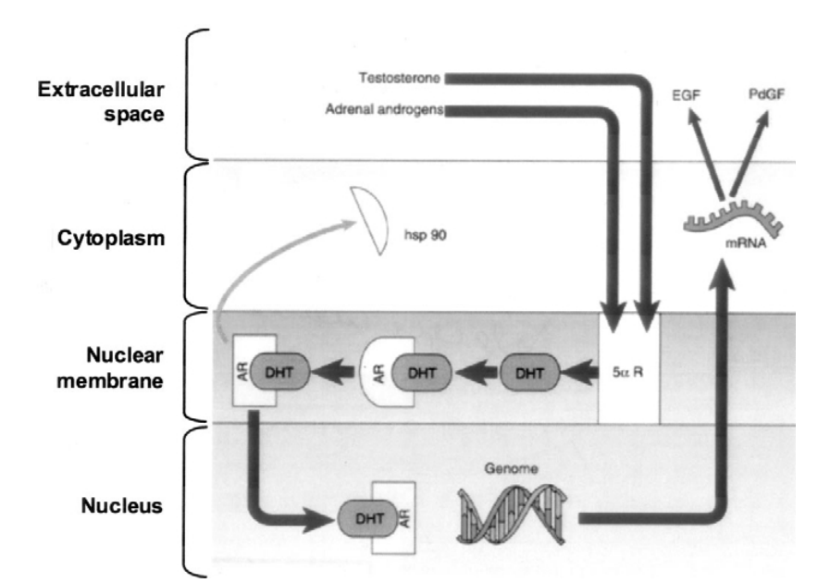
Andriole G, Bruchovsky N, Chung LW, Matsumoto AM, Rittmaster R, Roehrborn C, Russell D, Tindall D. Dihydrotestosterone and the prostate: the scientific rationale for 5alpha-reductase inhibitors in the treatment of benign prostatic hyperplasia. J Urol. 2004 Oct;172(4 Pt 1):1399-403. doi: 10.1097/01.ju.0000139539.94828.29. PMID: 15371854.

Slide 14
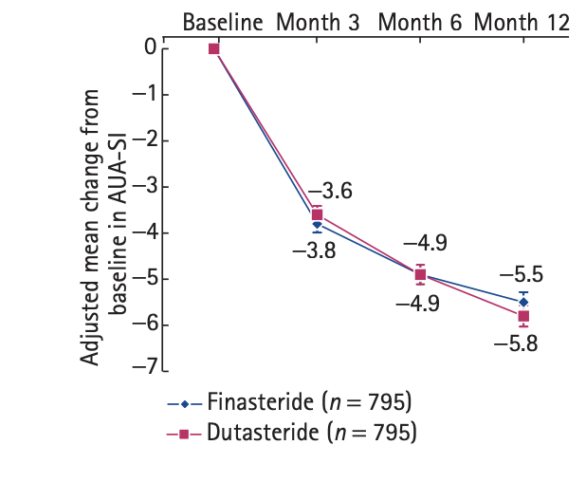
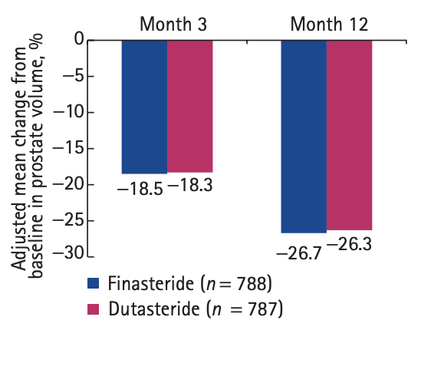
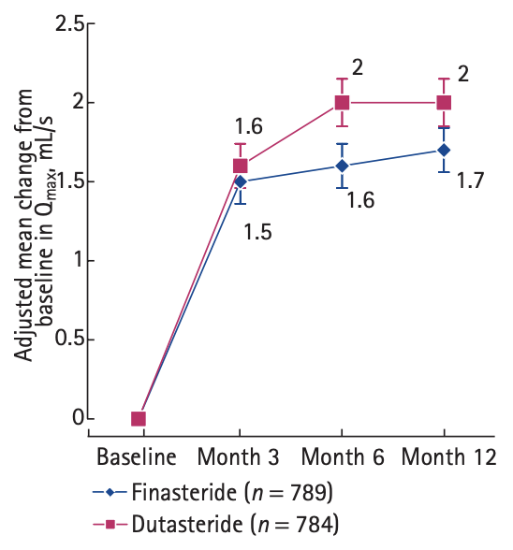
Nickel JC, Gilling P, Tammela TL, Morrill B, Wilson TH, Rittmaster RS. Comparison of dutasteride and finasteride for treating benign prostatic hyperplasia: the Enlarged Prostate International Comparator Study (EPICS). BJU Int. 2011 Aug;108(3):388-94. doi: 10.1111/j.1464-410X.2011.10195.x. Epub 2011 Jun 1. PMID: 21631695.

Slide 15
Donohue JF, Sharma H, Abraham R, Natalwala S, Thomas DR, Foster MC. Transurethral prostate resection and bleeding: a randomized, placebo controlled trial of role of finasteride for decreasing operative blood loss. J Urol. 2002 Nov;168(5):2024-6. doi: 10.1016/S0022-5347(05)64287-5. PMID: 12394700.

Slide 16
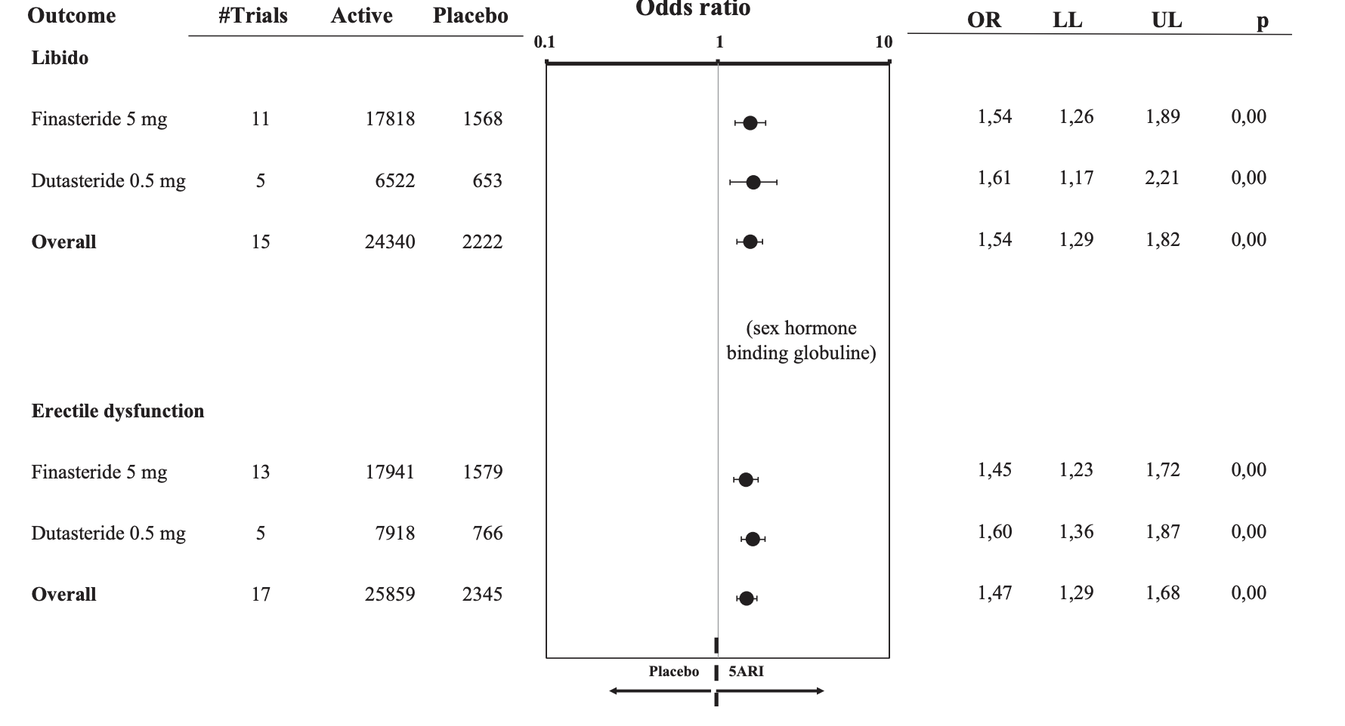
Corona G, Tirabassi G, Santi D, Maseroli E, Gacci M, Dicuio M, Sforza A, Mannucci E, Maggi M. Sexual dysfunction in subjects treated with inhibitors of 5α-reductase for benign prostatic hyperplasia: a comprehensive review and meta-analysis. Andrology. 2017 Jul;5(4):671-678. doi: 10.1111/andr.12353. Epub 2017 Apr 28. PMID: 28453908.

Slide 17
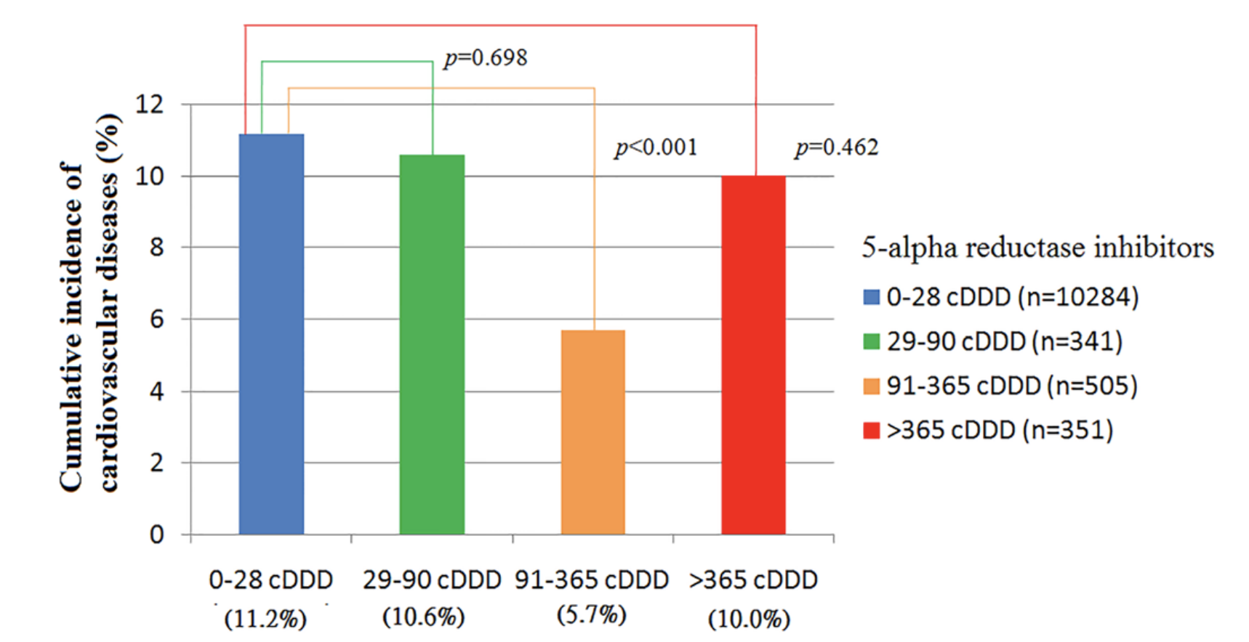
Hsieh TF, Yang YW, Lee SS, Lin TH, Liu HH, Tsai TH, Chen CC, Huang YS, Lee CC. Use of 5-alpha-reductase inhibitors did not increase the risk of cardiovascular diseases in patients with benign prostate hyperplasia: a five-year follow-up study. PLoS One. 2015 Mar 24;10(3):e0119694. doi: 10.1371/journal.pone.0119694. PMID: 25803433; PMCID: PMC4372445.

Slide 18
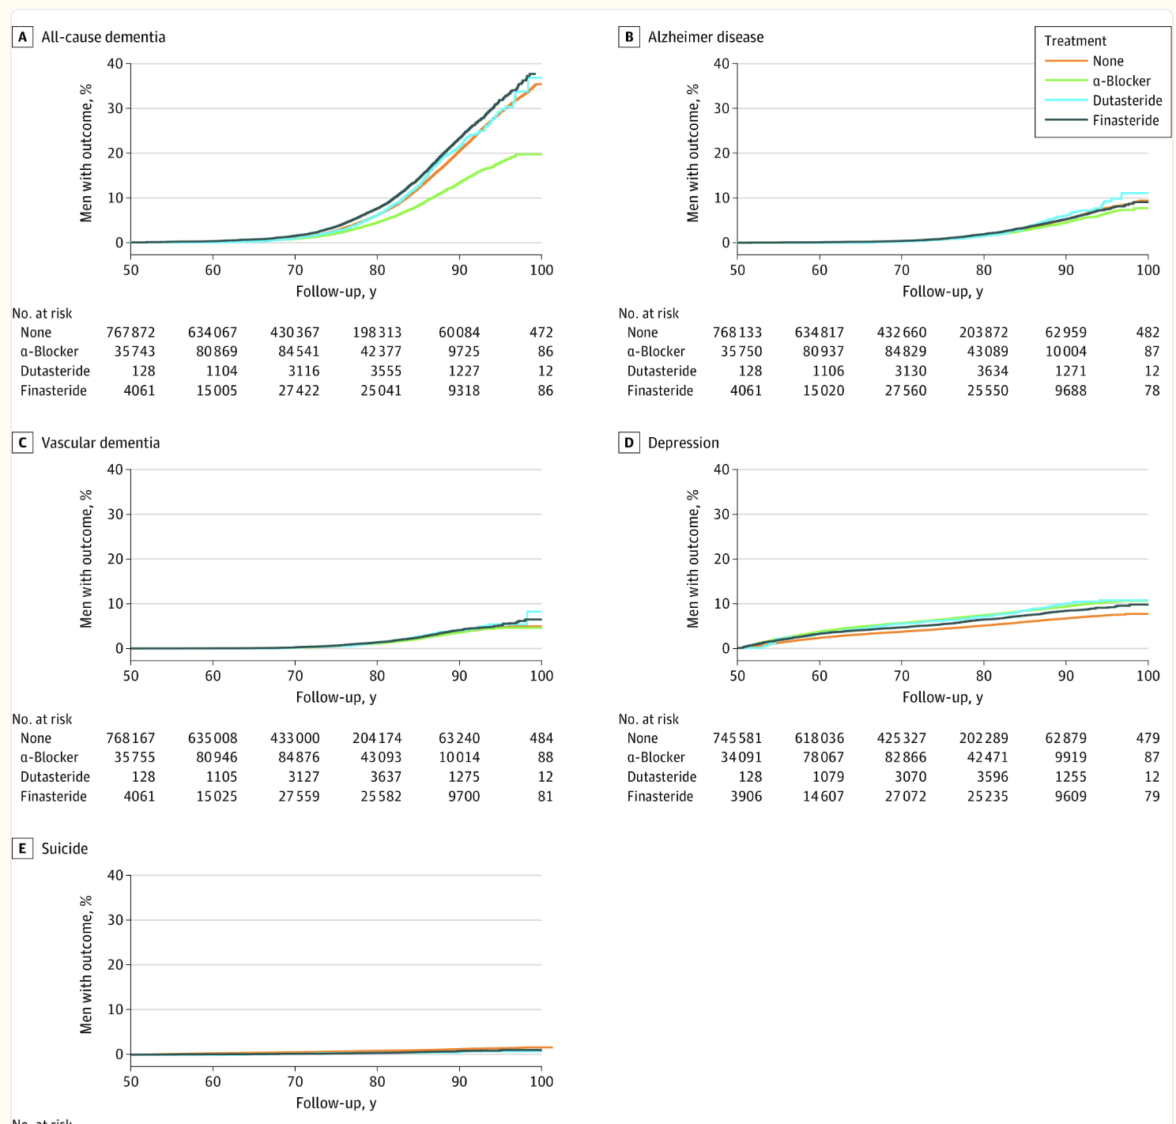
Garcia-Argibay M, Hiyoshi A, Fall K, Montgomery S. Association of 5α-Reductase Inhibitors With Dementia, Depression, and Suicide. JAMA Netw Open. 2022 Dec 1;5(12):e2248135. doi: 10.1001/jamanetworkopen.2022.48135. PMID: 36547981; PMCID: PMC9857015.

Slide 19
Management of Non-neurogenic Male LUTS. EAU Guidelines, 2025.

Slide 20
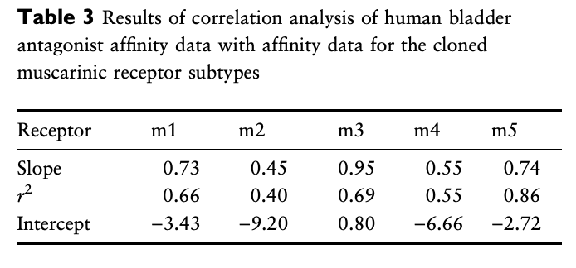
Chess-Williams R, Chapple CR, Yamanishi T, Yasuda K, Sellers DJ. The minor population of M3-receptors mediate contraction of human detrusor muscle in vitro. J Auton Pharmacol. 2001 Oct-Dec;21(5-6):243-8. doi: 10.1046/j.1365-2680.2001.00231.x. PMID: 12123469.

Slide 21
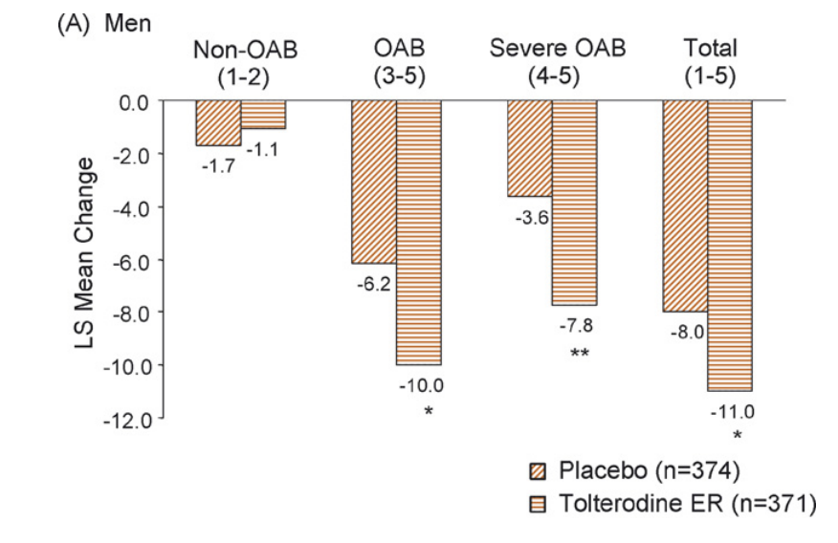
Dmochowski R, Abrams P, Marschall-Kehrel D, Wang JT, Guan Z. Efficacy and tolerability of tolterodine extended release in male and female patients with overactive bladder. Eur Urol. 2007 Apr;51(4):1054-64; discussion 1064. doi: 10.1016/j.eururo.2006.10.005. Epub 2006 Oct 20. PMID: 17097217.

Slide 22
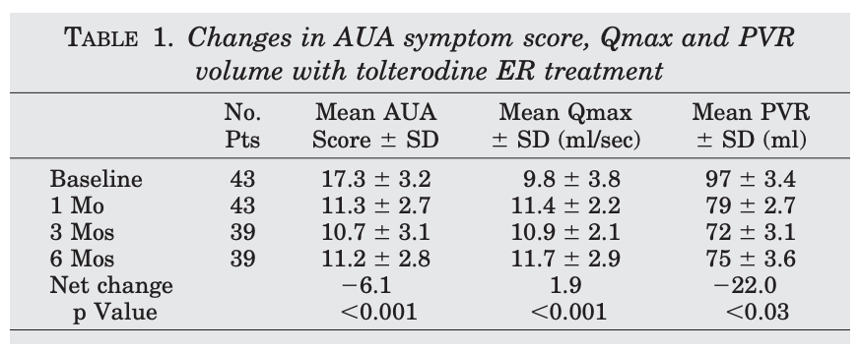
Kaplan SA, Walmsley K, Te AE. Tolterodine extended release attenuates lower urinary tract symptoms in men with benign prostatic hyperplasia. J Urol. 2005 Dec;174(6):2273-5. discussion 2275-6. doi: 10.1097/01.ju.0000181823.33224.a0. PMID: 16280803.

Slide 23
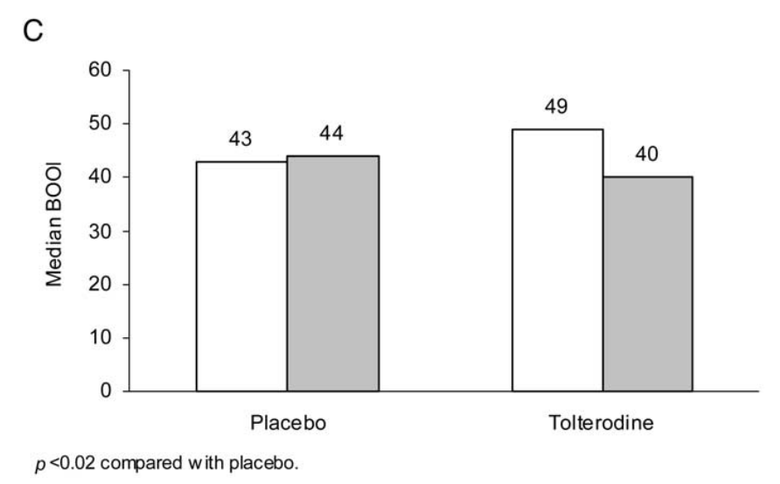
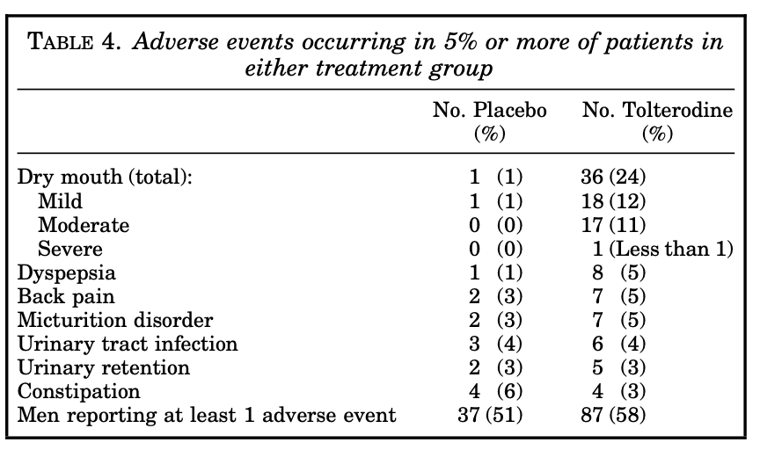
Abrams P, Kaplan S, De Koning Gans HJ, Millard R. Safety and tolerability of tolterodine for the treatment of overactive bladder in men with bladder outlet obstruction. J Urol. 2006 Mar;175(3 Pt 1):999-1004; discussion 1004. doi: 10.1016/S0022-5347(05)00483-0. PMID: 16469601.

Slide 24
Management of Non-neurogenic Male LUTS. EAU Guidelines, 2025.

Slide 25
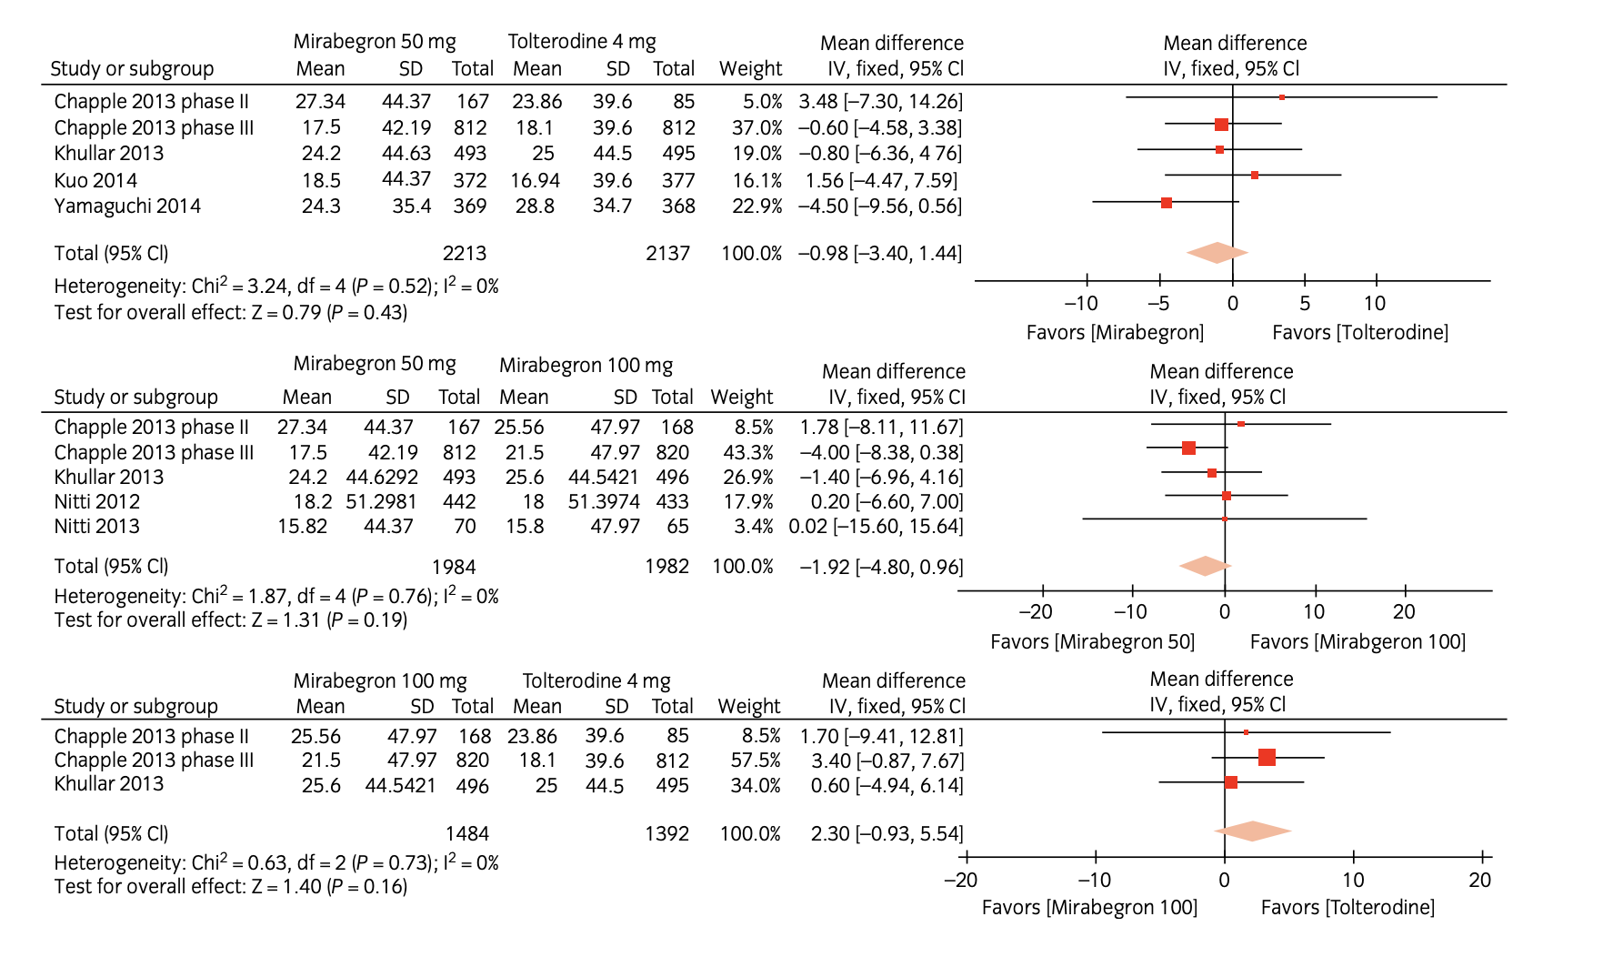
Sebastianelli A, Russo GI, Kaplan SA, McVary KT, Moncada I, Gravas S, Chapple C, Morgia G, Serni S, Gacci M. Systematic review and meta-analysis on the efficacy and tolerability of mirabegron for the treatment of storage lower urinary tract symptoms/overactive bladder: Comparison with placebo and tolterodine. Int J Urol. 2018 Mar;25(3):196-205. doi: 10.1111/iju.13498. Epub 2017 Dec 3. PMID: 29205506.

Slide 26
White WB, Siddiqui E, Tat T, Franks B, Schermer CR. Cardiovascular safety of mirabegron: analysis of an integrated clinical trial database of patients with overactive bladder syndrome. J Am Soc Hypertens. 2018 Nov;12(11):768-778.e1. doi: 10.1016/j.jash.2018.08.001. Epub 2018 Aug 10. PMID: 30181042.

Slide 27
Management of Non-neurogenic Male LUTS. EAU Guidelines, 2025.

Slide 28
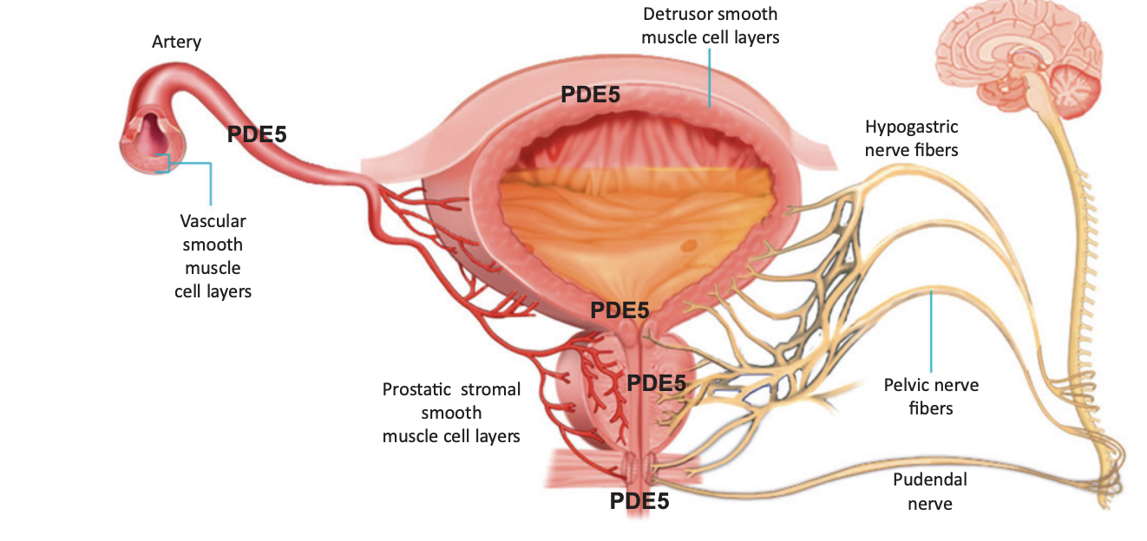
Giuliano F, Ückert S, Maggi M, Birder L, Kissel J, Viktrup L. The mechanism of action of phosphodiesterase type 5 inhibitors in the treatment of lower urinary tract symptoms related to benign prostatic hyperplasia. Eur Urol. 2013 Mar;63(3):506-16. doi: 10.1016/j.eururo.2012.09.006. Epub 2012 Sep 11. PMID: 23018163.

Slide 29
Guo B, Chen X, Wang M, Hou H, Zhang Z, Liu M. Comparative Effectiveness of Tadalafil versus Tamsulosin in Treating Lower Urinary Tract Symptoms Suggestive of Benign Prostate Hyperplasia: A Meta-Analysis of Randomized Controlled Trials. Med Sci Monit. 2020 Apr 24;26:e923179. doi: 10.12659/MSM.923179. PMID: 32327621; PMCID: PMC7195607.

Slide 30
Management of Non-neurogenic Male LUTS. EAU Guidelines, 2025.

Slide 31
Management of Non-neurogenic Male LUTS. EAU Guidelines, 2025.

Slide 32
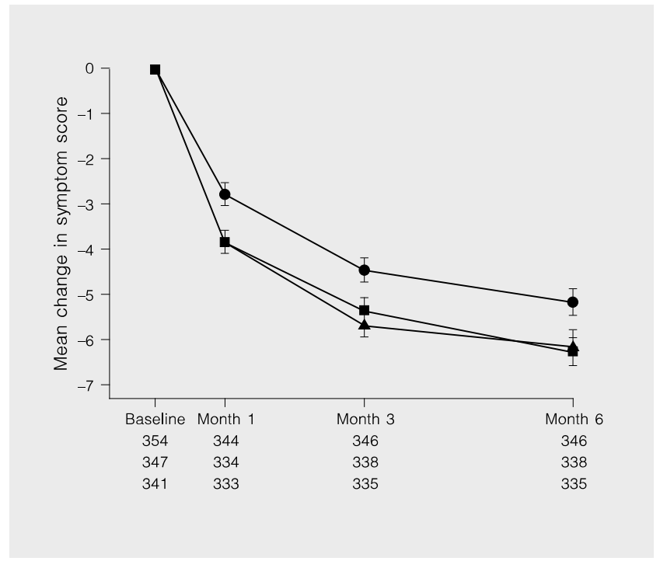
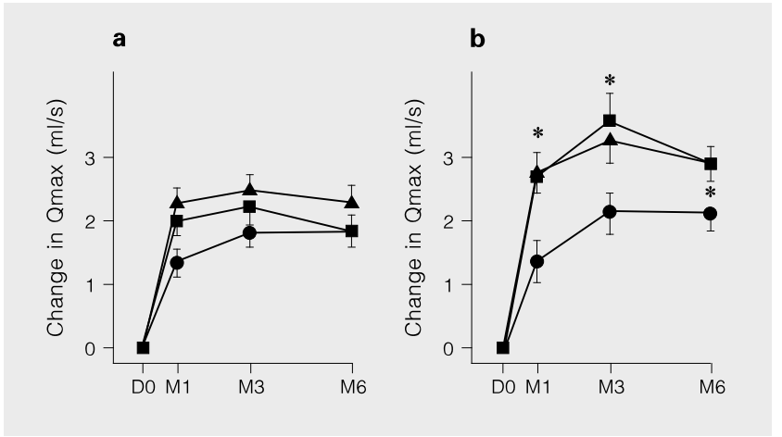
Debruyne FM, Jardin A, Colloi D, Resel L, Witjes WP, Delauche-Cavallier MC, McCarthy C, Geffriaud-Ricouard C. Sustained-release alfuzosin, finasteride and the combination of both in the treatment of benign prostatic hyperplasia. European ALFIN Study Group. Eur Urol. 1998 Sep;34(3):169-75. doi: 10.1159/000019706. PMID: 9732187.

Slide 33
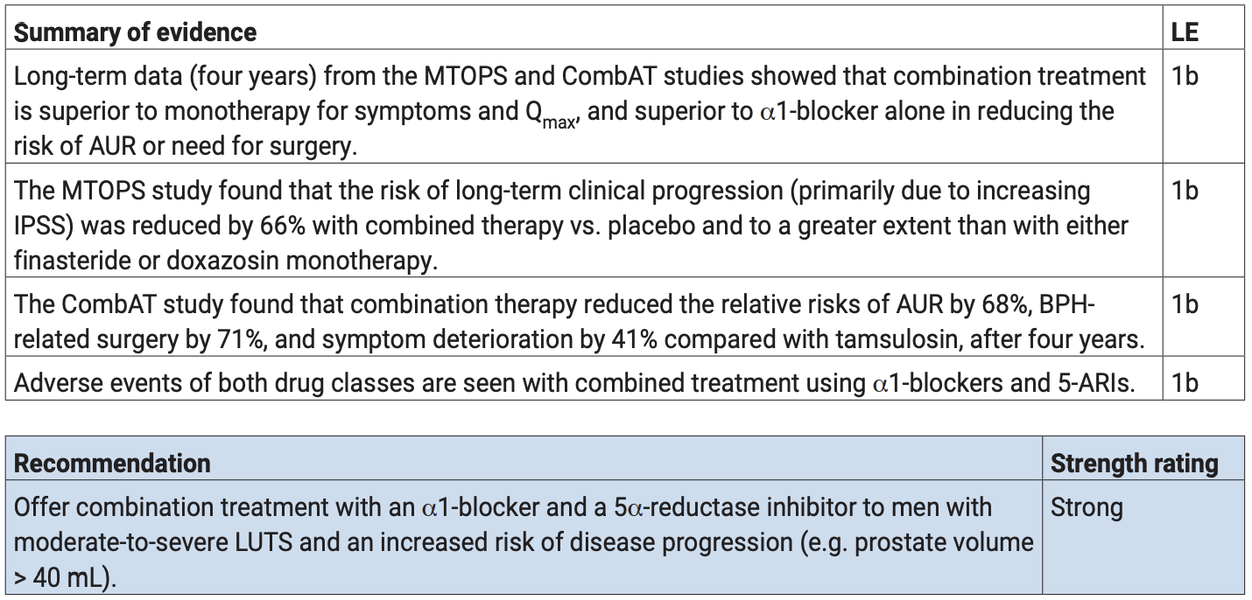
Management of Non-neurogenic Male LUTS. EAU Guidelines, 2025.

Slide 34
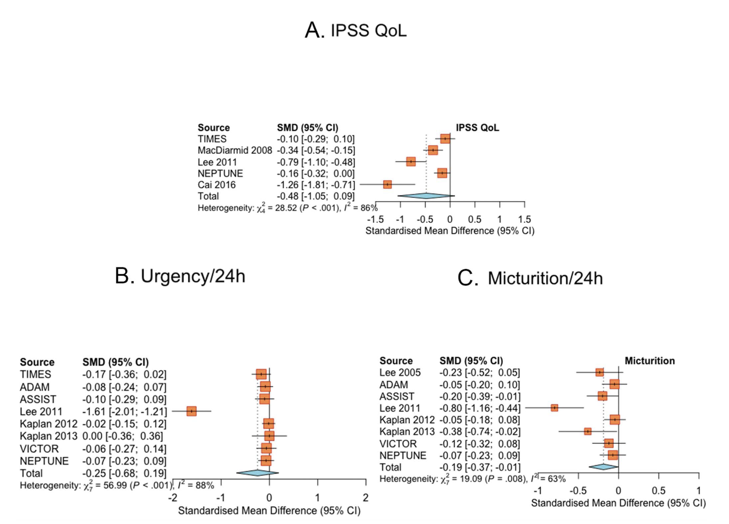
Lenfant L, Pinar U, Roupret M, Mozer P, Chartier-Kastler E, Seisen T. Role of Antimuscarinics Combined With Alpha-blockers in the Management of Urinary Storage Symptoms in Patients With Benign Prostatic Hyperplasia: An Updated Systematic Review and Meta-analysis. J Urol. 2023 Feb;209(2):314-324. doi: 10.1097/JU.0000000000003077. Epub 2022 Nov 17. PMID: 36395428.

Slide 35
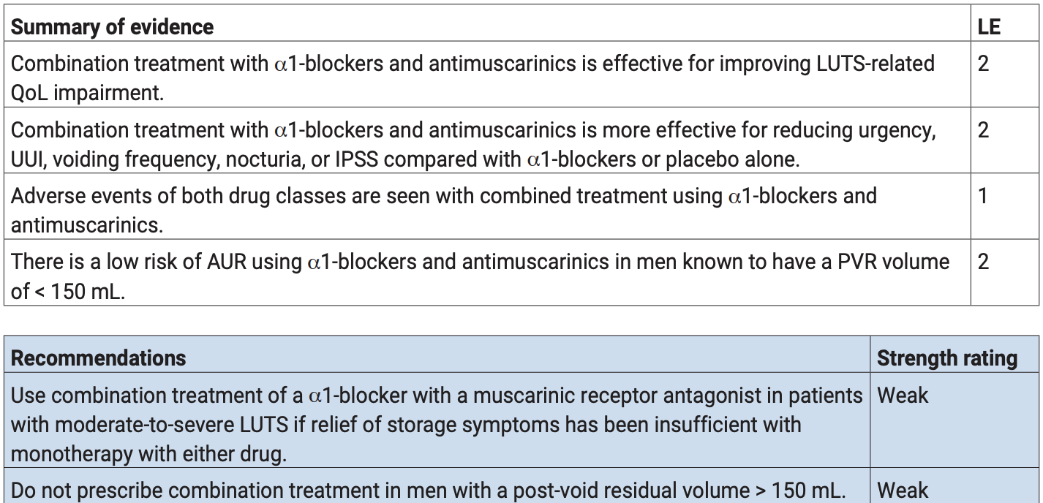
Management of Non-neurogenic Male LUTS. EAU Guidelines, 2025.

Slide 36
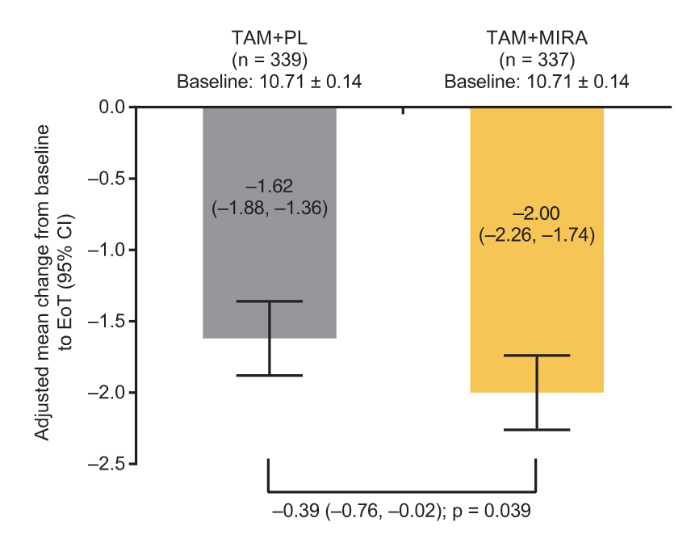
Kaplan SA, Herschorn S, McVary KT, Staskin D, Chapple C, Foley S, Cambronero Santos J, Kristy RM, Choudhury N, Hairston J, Schermer CR. Efficacy and Safety of Mirabegron versus Placebo Add-On Therapy in Men with Overactive Bladder Symptoms Receiving Tamsulosin for Underlying Benign Prostatic Hyperplasia: A Randomized, Phase 4 Study (PLUS). J Urol. 2020 Jun;203(6):1163-1171. doi: 10.1097/JU.0000000000000738. Epub 2020 Jan 2. PMID: 31895002.

Slide 37
Management of Non-neurogenic Male LUTS. EAU Guidelines, 2025.

Slide 38
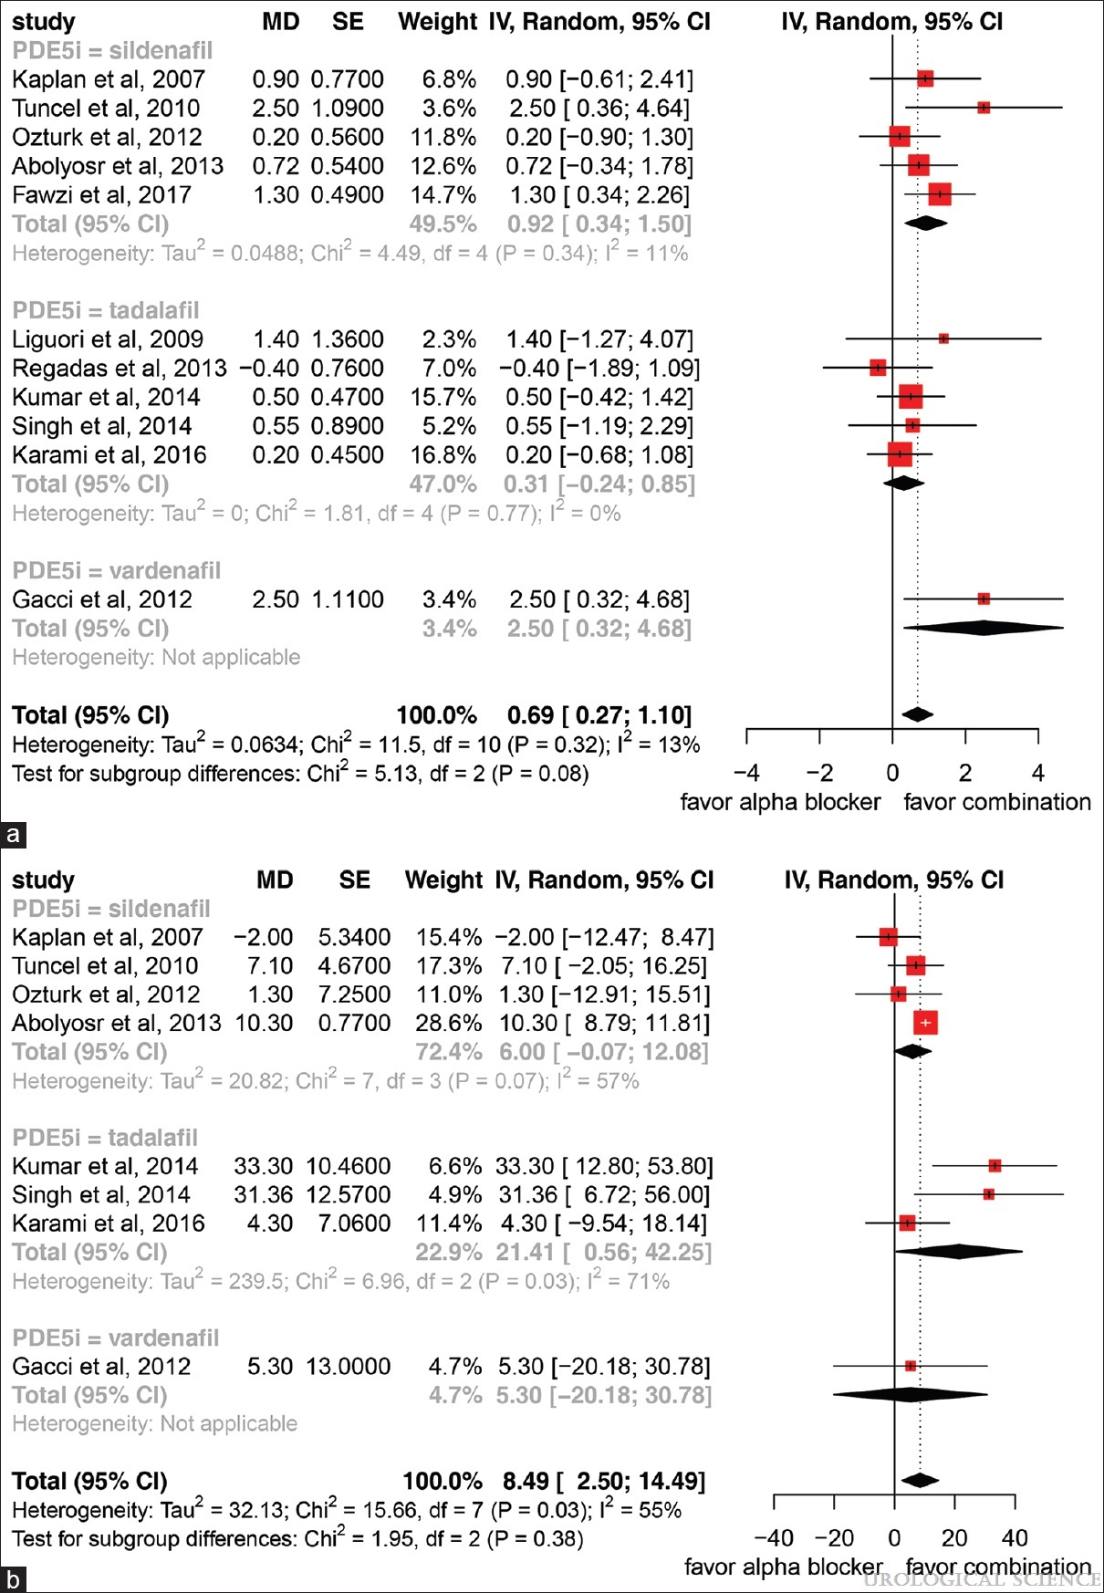
Chen, Po-Cheng1,2; Wang, Chung-Cheng3; Tu, Yu-Kang2,*. Combination Alpha Blocker and Phosphodiesterase 5 Inhibitor Versus Alpha-Blocker Monotherapy for Lower Urinary Tract Symptoms Associated with Benign Prostate Hyperplasia: A Systematic Review and Meta-Analysis. Urological Science 31(3):p 99-107, May–Jun 2020. | DOI: 10.4103/UROS.UROS_59_19

Slide 39
Management of Non-neurogenic Male LUTS. EAU Guidelines, 2025.

Slide 40
CONCLUSIONES
El manejo farmacológico de la HBP reporta múltiples opciones.
Se debe valorar los mecanismos de acción y las comorbilidades para disminuir los eventos adversos serios.
Las combinaciones mejoran ciertos síntomas y signos de la enfermedad.
En quienes el manejo sea muy difícil o refractario, la cirugía mínimamente invasiva es el siguiente paso.
Converse permanentemente con el urólogo.

Slide 41
Gracias.

